Slide 1
Introduction to Database Systems

Slide 2
Role of Data in Computer
Data
A collection of facts (numbers, words, measurements, observations, etc) that has been translated into a form that computers can process.
Introduction to Database Systems

Slide 3
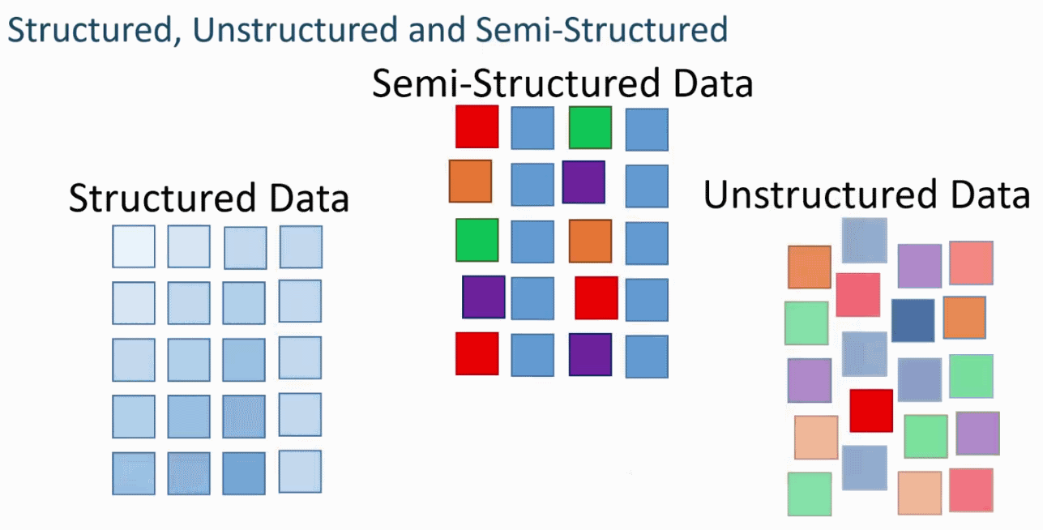
Types of Data
Structured data
Information stored DB
Strict format
Semi-structured data
Data may have certain structure but not all information collected has
identical structure
Some attributes may exist in some of the entities of a particular type but not in others
Unstructured data
Very limited indication of data type
E.g., a simple text document
Notes:
Think of data that fits neatly within fixed fields and columns in relational databases and spreadsheets. Examples of structured data include names, dates, addresses, credit card numbers, stock information, geolocation, and more. Structured data is highly organized and easily understood by machine language.

Slide 4
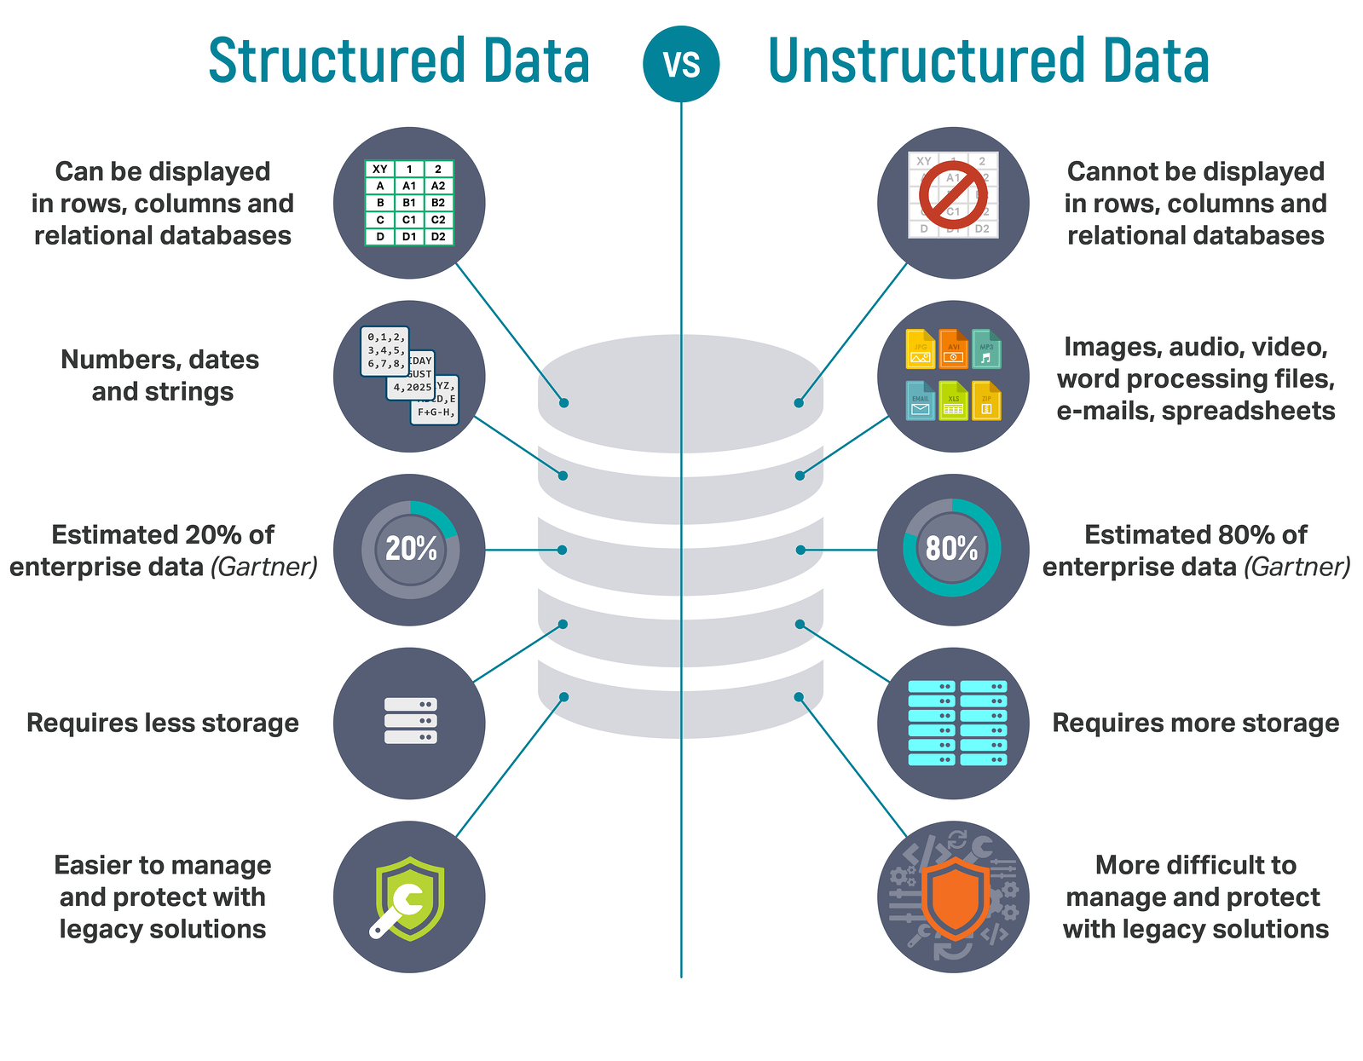
Notes:
Structured data is easier to search and analyze, while unstructured data requires more effort to process. Structured data media is much richer, while unstructured data media is much more sparse. Structured data comes in formats like audio and video, while unstructured data is found in tabular and Excel. data formats.

Slide 5
Why Study Databases?
Databases are useful
Majority of the computing applications deal with large amounts of information
Database systems give a set of tools for storing, searching and managing this information
Databases in CS
Databases are a ‘core topic’ in computer science
Basic concepts and skills with database systems are part of the skill set you will be assumed to have as a IT graduate

Slide 6
What is a Database?
“A set of information held in a computer”
Oxford English Dictionary
“One or more large structured sets of persistent data, usually associated with software to update and query the data”
Free On-Line Dictionary of Computing
“A collection of data arranged for ease and speed of search and retrieval”
Dictionary.com
Notes:
a database is an organized collection of data stored and accessed electronically. Small databases can be stored on a file system, while large databases are hosted on computer clusters or cloud storage.

Slide 7
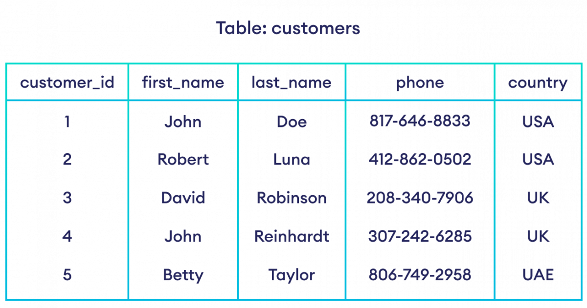
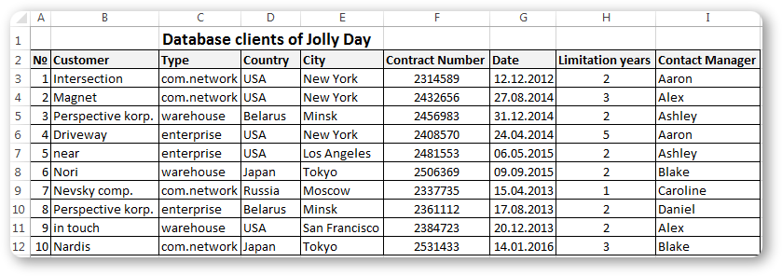

Slide 8
Database Examples
Library catalogues
Medical records
Bank accounts
Stock control
Product catalogues
Telephone directories
Train timetables
Airline bookings
Credit card details
Student records
Customer histories

Slide 9
Components of Database Systems
Data
Users
Hardware
Software
We focus mainly on the software

Slide 10
Store
Update
Retrieve
Organize
Protect
Functions of Database System

Slide 11
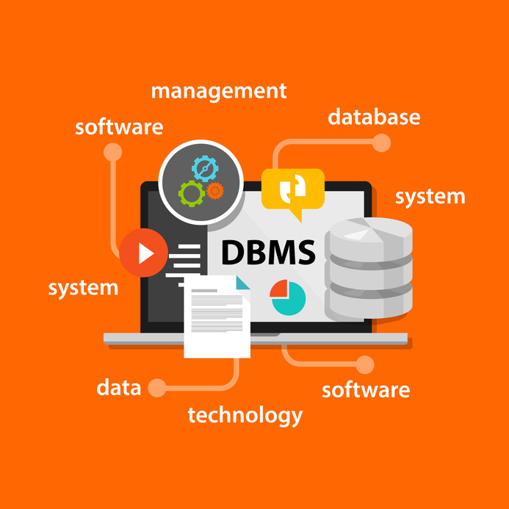

Slide 12
Database Management Systems
A database is a collection of information
A database management system (DBMS) is the software than controls that information
Examples:
Oracle
DB2 (IBM)
MS SQL Server
MS Access
Ingres
PostgreSQL
MySQL

Slide 13
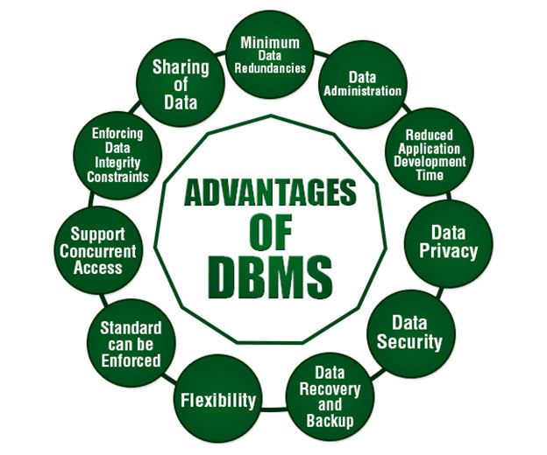
Notes:
Persistence
Concurrency
Integrity
Security
Data independence
Data concurrency is the ability to allow multiple users to affect multiple transaction within a database. Simply, data concurrency allows multiple users to access data all at the same time. The ability to offer concurrency is unique to databases.

Slide 14
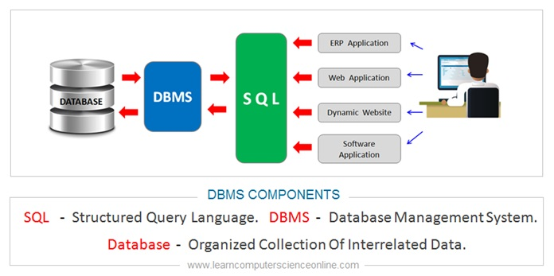
What the DBMS does?

Slide 15
Types of SQL Statements
DDL stands for Data Definition Languages (DDL).
The SQL statements that are used to define the database structure. Any CREATE, DROP and ALTER commands are examples of DDL SQL.
DML stands for Data Manipulation Language
The SQL statements that are in the DML class are INSERT, UPDATE and DELETE.
DCL stands for Data Control Language
it includes commands such as GRANT and REVOKE which mainly deals with the rights, permissions and other controls.

Slide 16
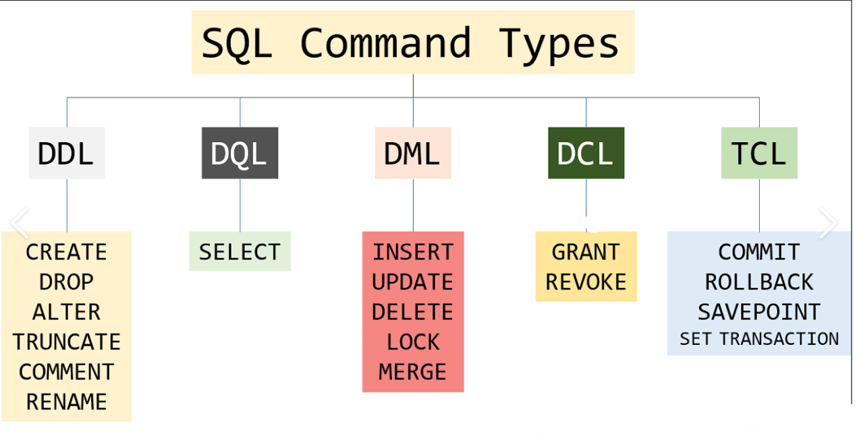
Notes:
Transaction Control Language commands are used to manage transactions in the database. These are used to manage the changes made by DML-statements. It also allows statements to be grouped together into logical transactions

Slide 17
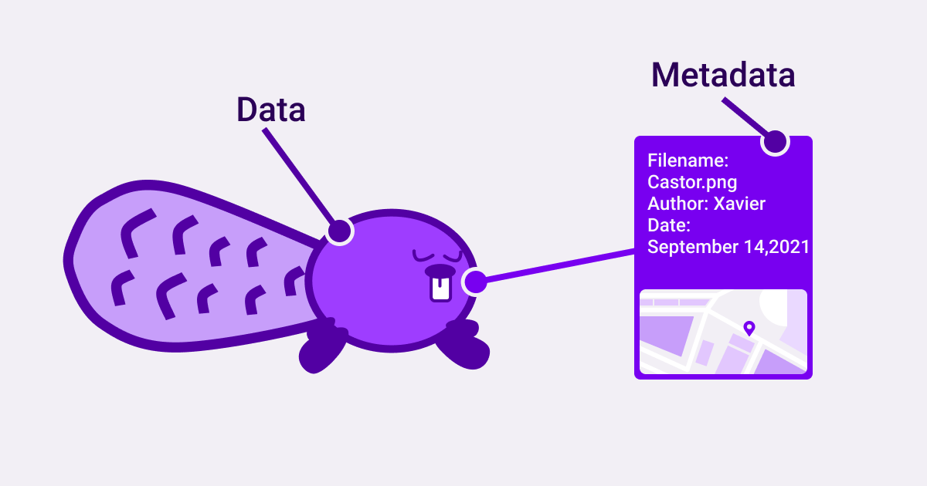

Slide 18
Data Dictionary - Metadata
The dictionary or catalog stores information about the database itself
This is data about data.
Data source(data warehouse, data lakes, databases, applications) Tables names and descriptions. Table relationships. Number of columns, column name, and descriptions.

Slide 19
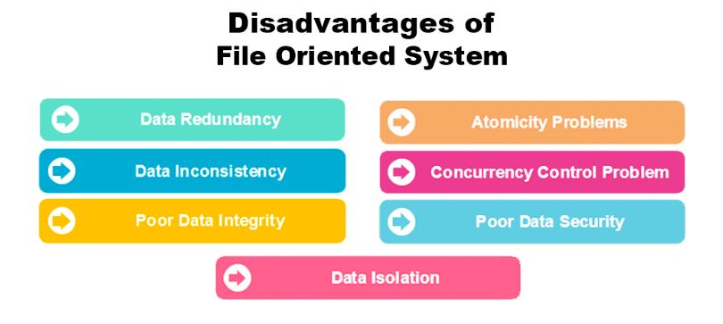
File Based Systems
File based systems
Data is stored in files
Each file has a specific format
Programs that use these files depend on knowledge about that format

Slide 20
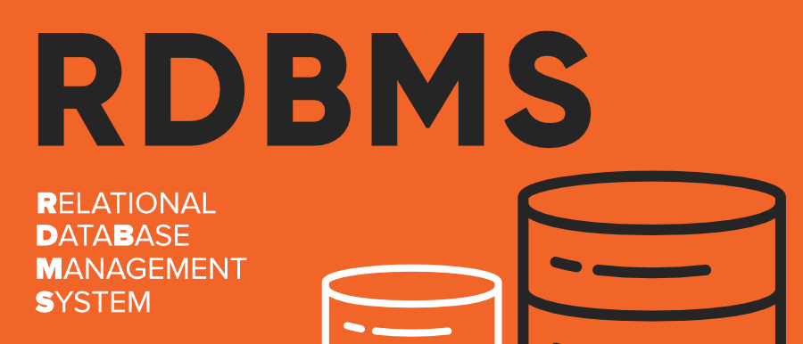
Relational Database Management System
A relational database management system (RDBMS or just RDB) is a common type of database that stores data in tables, so it can be used in relation to other stored datasets.
Most databases used by businesses these days are relational databases, as opposed to a flat file or hierarchical database.

Slide 21
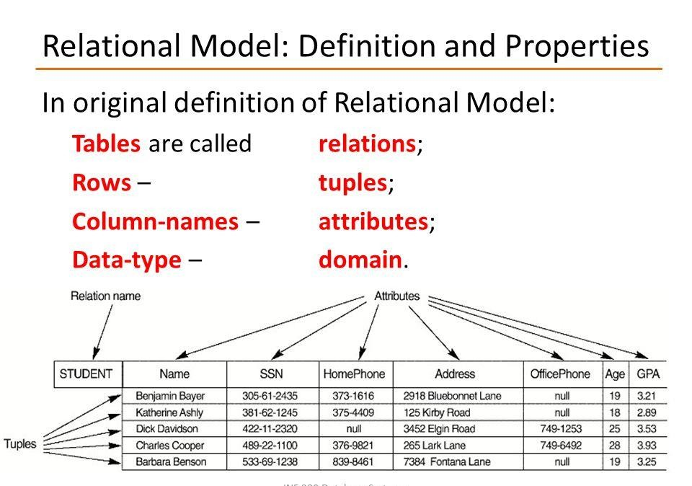
Relational Systems

